Slide 1
Cyclistic Case Study
Google Data Analytics Professional Certificate - Capstone Project
By Harrison Chambers

Slide 2
Background
Cyclistic (fictional name, real data) is a bike-share company based in Chicago, IL
They offer a variety of bike options, including reclining bikes, hand tricycles, and cargo bikes
The company differentiates customers who purchase single-ride and full-day passes as “casual” members, whereas those who buy annual memberships are “annual” members
The director of marketing believes the company’s future success depends on maximizing the number of annual memberships
The team wants to understand how casual and annual riders use Cyclistic bikes differently in order to convert casual riders into annual members
The following analysis is based off of the case and accompanying data (see appendix)

Slide 3
Key Findings
Annual members are more likely to use the bikes for “utility” type trips, like commuting to work, or a short trip to the store.
Casual members are more likely to use the bikes for “leisure” activities such as exercise and enjoyment.

Slide 4
Recommendations
To convert casual members into annual members, Cyclistic could run a marketing campaign focused on the benefits of using bikes as a form of transit rather than bikes just being for sport.
They might also consider a message that focuses on the benefit of commuting by bike as opposed to other forms of transportation.
Lastly, they could introduce an incentive designed to get casual riders using their bikes more like annual members i.e. “If you take five trips under 20 minutes this month, get 20% off an annual membership”.

Slide 5
Analysis
The following analysis will provide insight into how casual and annual members use Cyclistic bicycles differently.
All data and charts presented reflect the year December 1, 2020 - November 30, 2021.
Note that the monthly charts start at January, so they jump from November 2021 backwards to December 2020.

Slide 6
Annual members ride more, on shorter trips
Annual members accounted for 55% of all trips, with the remaining being casual members.
Casual members rode for an average of 32 minutes per trip.
Annual members took shorter trips on average, riding only 14 minutes on average.

Slide 7
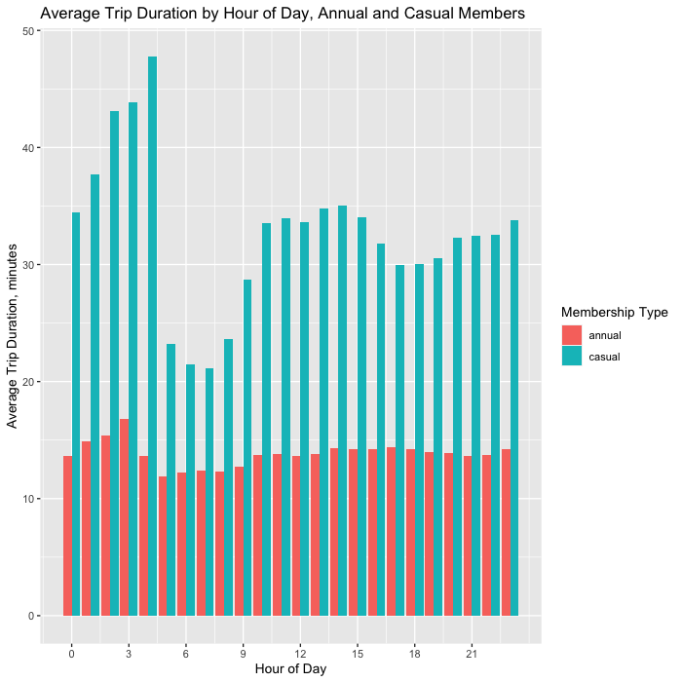
Annual members ride roughly the same amount hour-to-hour.
Casual members take their longest trips between midnight and sunrise.
Then they take their shortest trips between 5-10am.
Casual members always tend to take longer trips than annual members, regardless of the time of day.

Slide 8
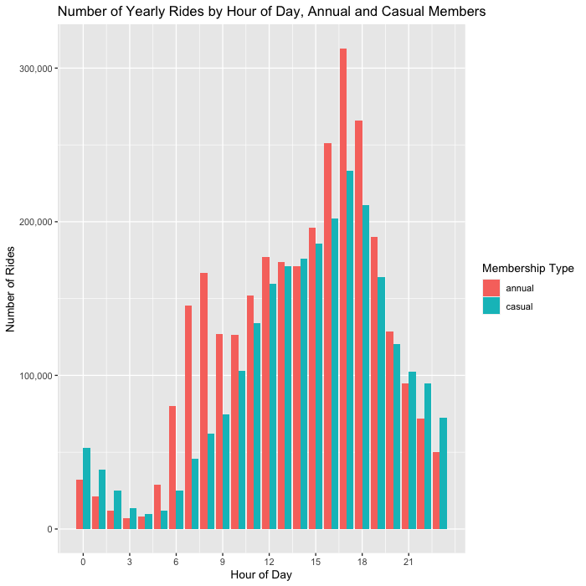
Annual members ride more often during peak commuter hours.
Annual members took many more trips between the hours of 5am-10am and 4pm-7pm compared to casual members.
Casual members took more trips between 9pm-5am, though far fewer trips were taken overall during this period.

Slide 9
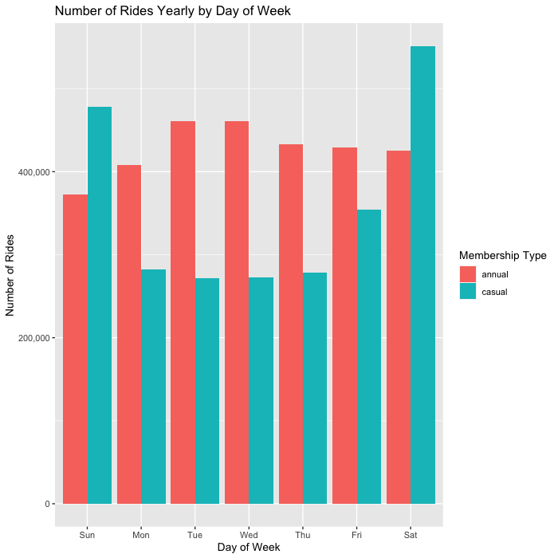
Annual members ride bikes more during the weekdays.
Casual members ride more during the weekend.
The difference is slightly less pronounced on Friday.

Slide 10
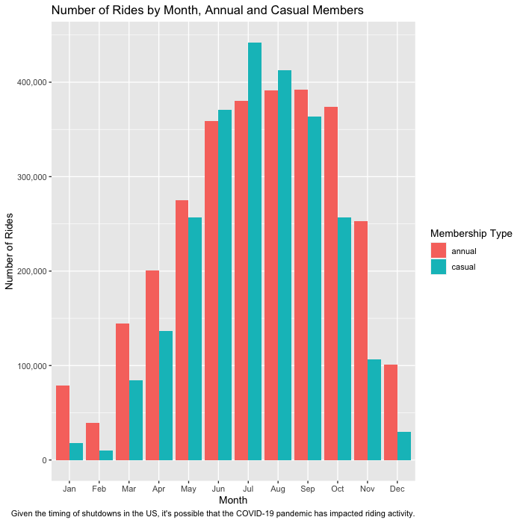
Annual members take more trips than casual members in the winter months.
Ridership peaks during the summer for all members, but annual members are more likely to ride in the winter, taking 78,344 more rides per month from October-April.
Ridership numbers were close through May, June, August and September. Casual members took 61,694 more trips than annual members in July.

Slide 11
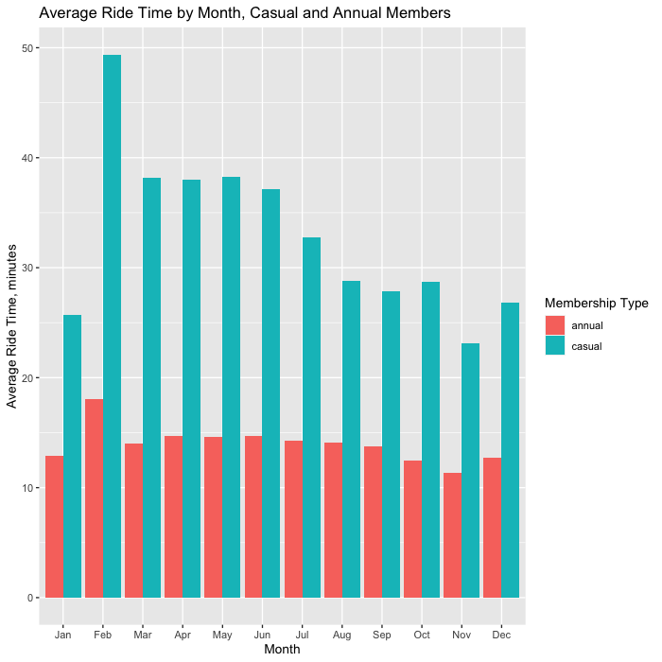
Casual members average trip length varies more month-to-month.
Both types of members ride the longest in February and shortest in November.
Casual members ride for nearly 50 minutes in February.
Annual members ride for only 11 minutes in November.

Slide 12
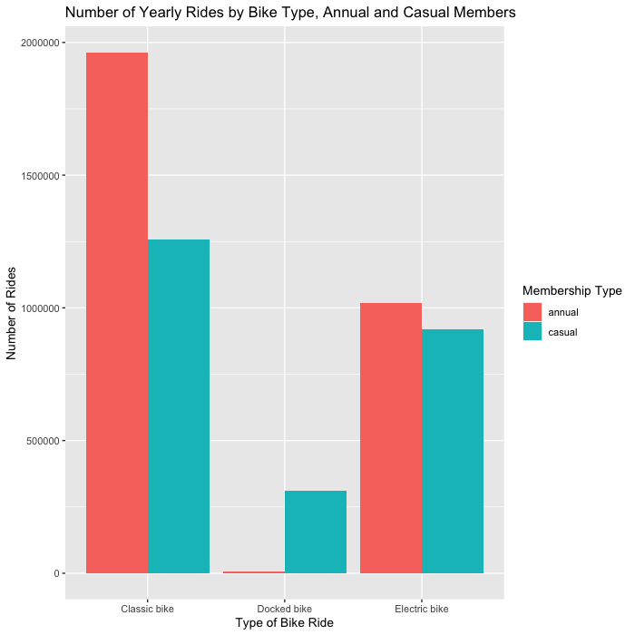
Annual members ride classic bikes more.
Casual members ride docked bikes more.
Electric bikes are a popular option for both members.

Slide 13
Conclusion
Casual members are the “weekend warriors” of Cyclistic’s ridership. They take longer rides and are probably using the bikes for leisure or exercise as opposed to utility.
Annual members take shorter trips and are more likely to commute to work on Cyclistic bikes. They also are more likely to ride during the winter and in general, their usage is more consistent than casual members.
In order to convert casual members to annual members, Cyclistic may consider targeted campaigns centered around promoting the usage patterns of annual members to casual members.

Slide 14
Appendix
The accompanying folder contains the following:
Original source data (12 .csv files, one for each month)
Source code used for data analysis and creation of visuals
The case file which contains additional context on the company, Cyclistic, and the aims of the case

